Slide 1

Transfer-Matrix Abstraction To Analyze The Effect Of Manufacturing Variations In Silicon Photonic Circuits
Team: Carlos Gonzalez
Faculty Advisors: Dr. Priyank Kalla,
Dr. Angela Rasmussen

Slide 2

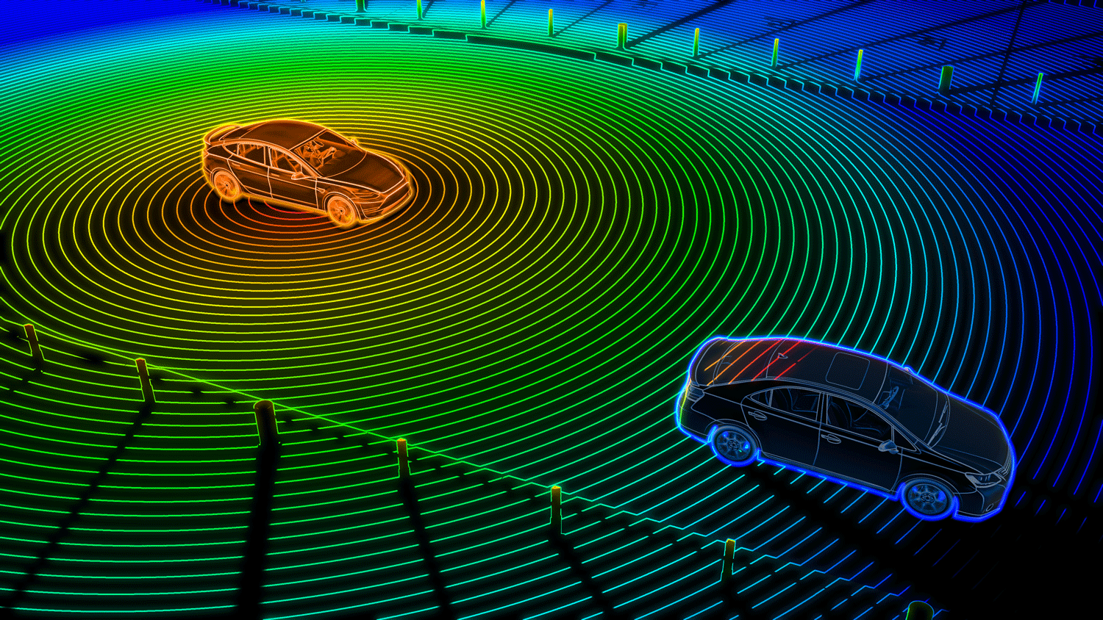
Motivation
The emergence of Silicon (Si) photonics necessitates the development of automated testing and validation techniques/tools.
Si photonics have widespread applications in fields such as communication, signal processing, quantum, reversible computation and optical sensing.

Slide 3
Background Info
Silicon waveguides are transparent to telecommunication wavelength range enabling them to guide the transmission of a wave in the medium.
Silicon and silicon dioxide are ideal for constructing optical waveguides given the large refractive index contrast between the two, we focus on transmission at 1550nm.
We can represent optical systems with transfer matrices.

Slide 4
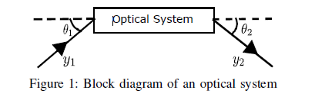
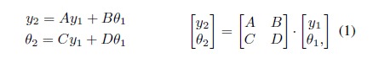
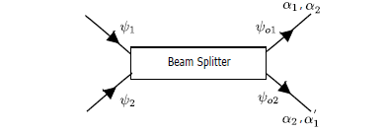
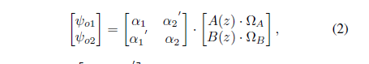
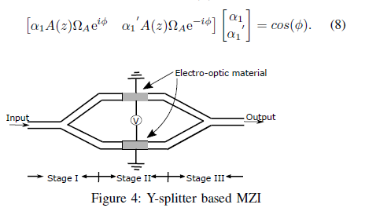
Optical Systems & Transfer Matrices

Slide 5
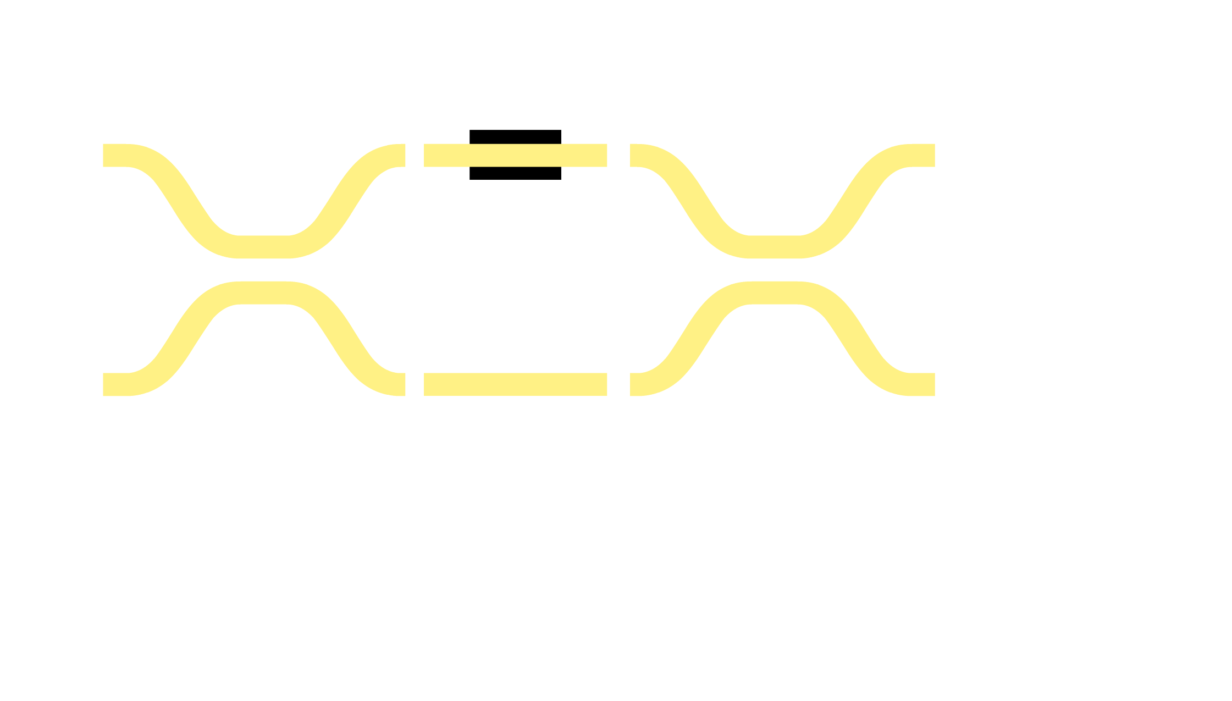




Mach-Zehnder Interferometer (MZI)
S = 0 → Δφ = π → bar
S = 1 → Δφ = 0 → cross

Slide 6
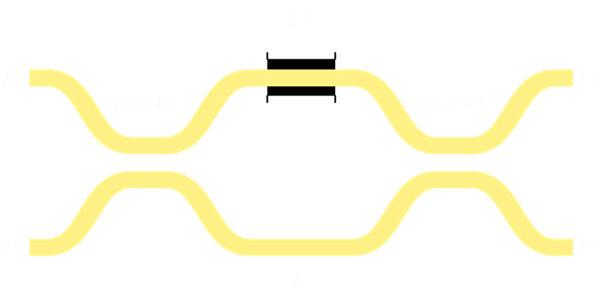
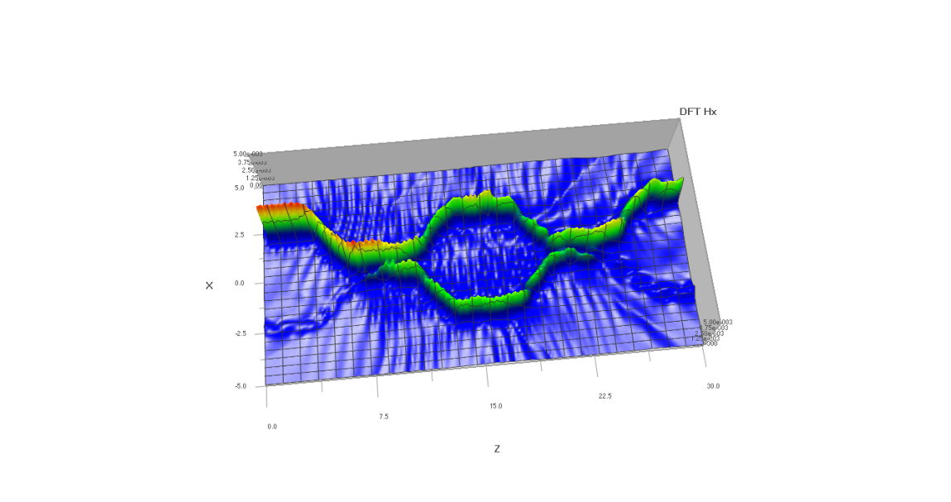
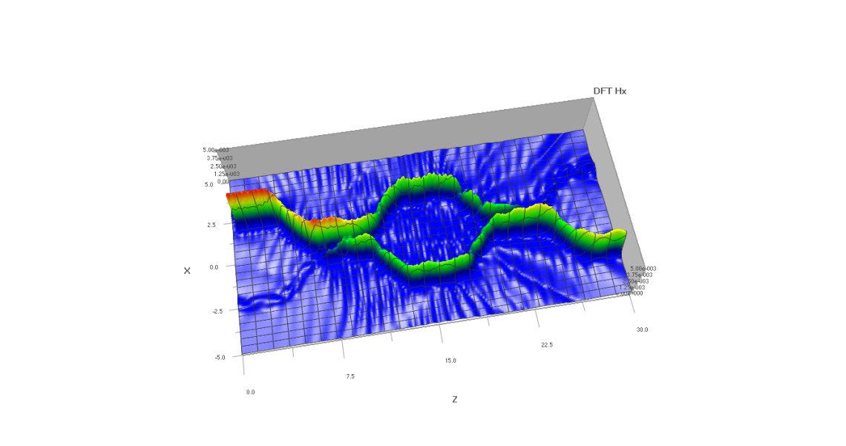
Crossbar Gates – Logic Building Block
Electrically controlled 2x2 Optical Router (“switch”)
s = electrical primary input
a, b, c, d = optical waveguides
Crossbar Gate
S = 0 (bar) → (a = c, b = d)
S = 1 (cross) → (a = d, b = c)

Slide 7
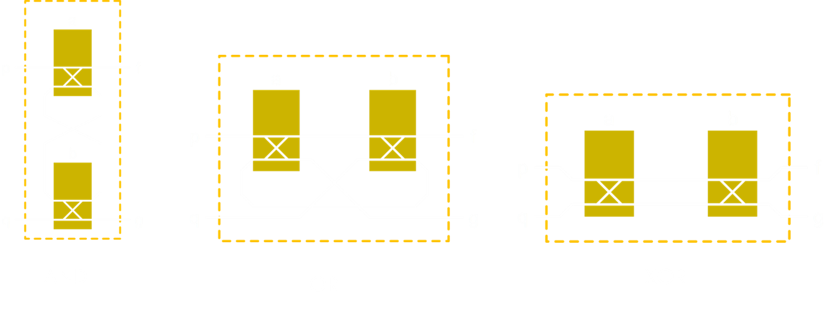
Virtual Gate Operators

Slide 8
I have and & ors I can make a circuit.
Use a circuit example here to illustrate using mzis and also what happens with a defect.

Slide 9
Goals
Create a python program that can simulate and run silicon photonic circuits using a more structured procedure. User’s can also use the virtual gates as “building blocks” to build photonic circuits.
Create a file format to store and read optical photonic circuits
Extract functional parameters in transfer matrices for simulation.
Solution of transfer matrices to help in computing outputs for simulation. Transfer matrices are an abstraction for quick solving instead of using FDTD methods.

Slide 10
Current Work
I am currently working on building the classes for each optical system. Once I have all the needed classes, I will start creating the main program that reads in a circuit file.
Successfully replicated the Ph.D. student’s simple simulation with my implementation and code structure.
Started building the MZI class first.

Slide 11
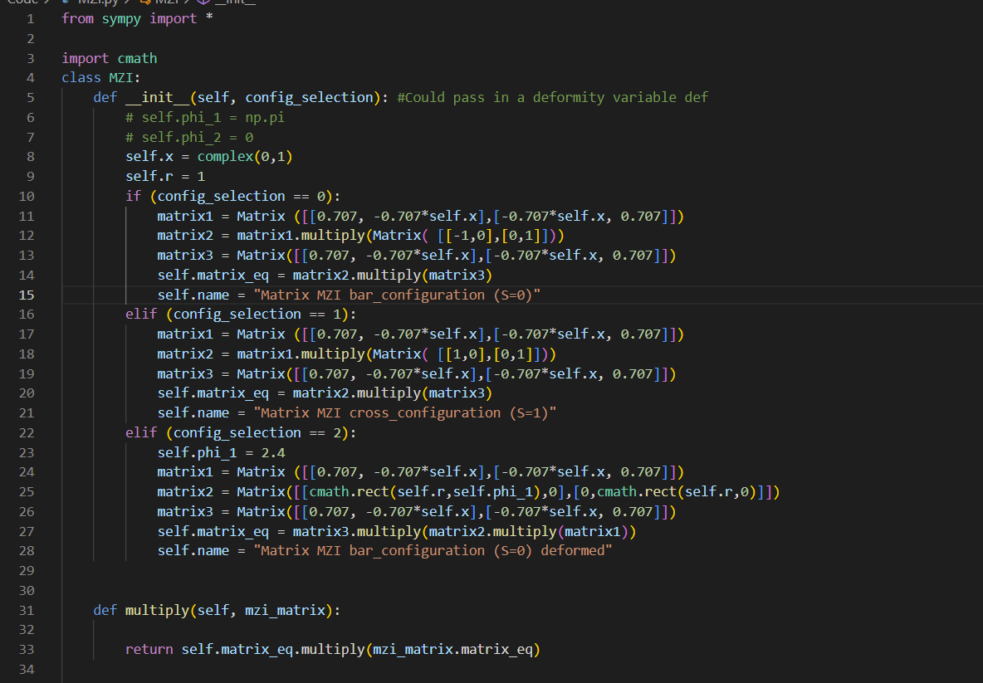
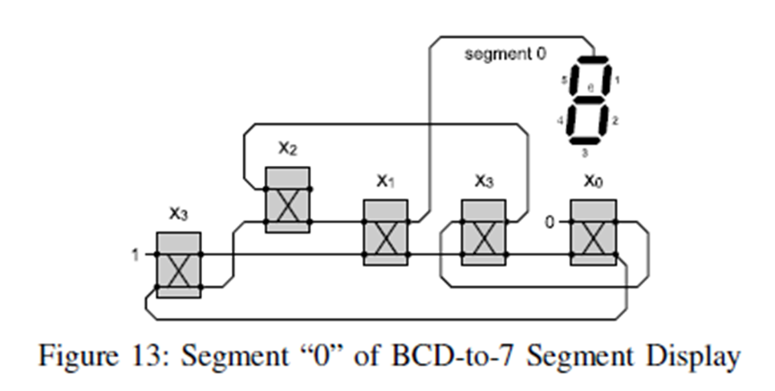
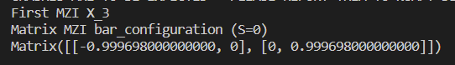
1st Experiment
Recreate this circuit with my structured python program.

Slide 12
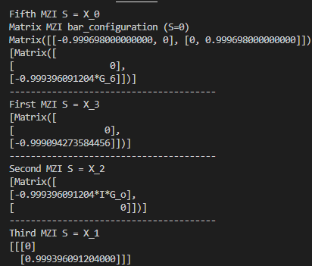
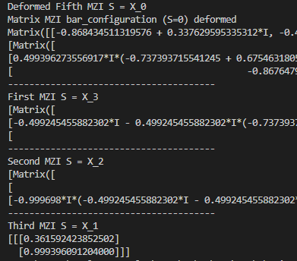
1st Experiment Cont..

Slide 13
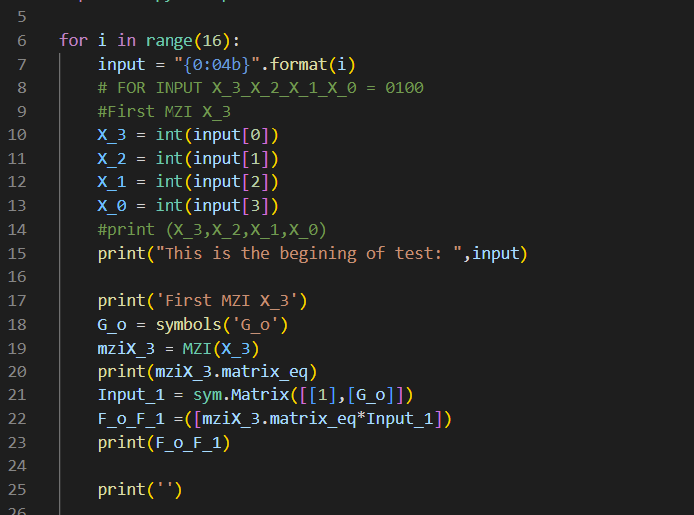
2nd Experiment
Now I am running through all 16 input entries for X_{0,} X_{1,} X_{2,} X_{3.}
Interested in seeing how the circuit will react
Dead loops
No Output

Slide 14
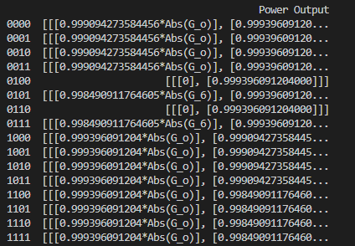
2nd Experiment cont..
Findings:
Dead loops
Working Inputs

Slide 15
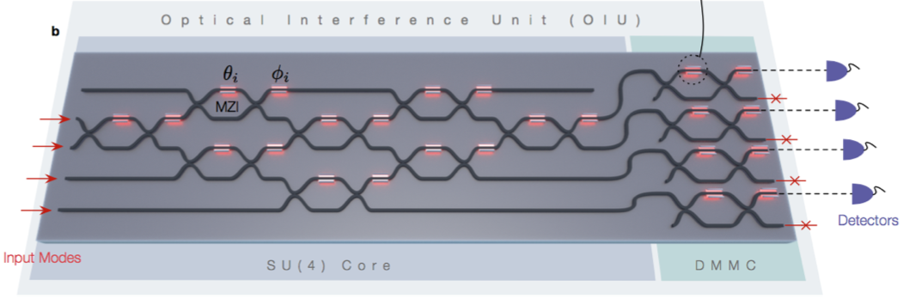
Conclusion
Useful tool to test more complex linear optical circuits.
A high-level abstraction to validate silicon photonic circuits.
Can help analyze the effect of manufacturability variations and defects in silicon photonic circuits.

Slide 16
Thank You

